Slide 1
Presentatión English

Slide 2
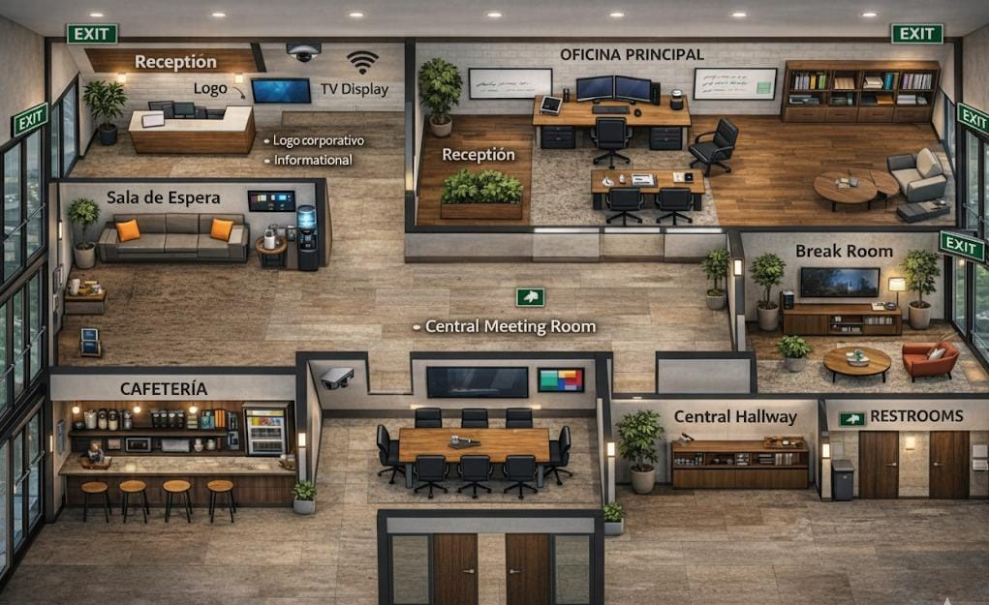
My Workplace
Our ideal workplace would be a spacious area with different spots to explore.
Reception
Waiting Room
Main Office
Work Area
Central Meeting
Room Central
Hallway
Cafeteria
Break Room
Restrooms
Information Area

Slide 3
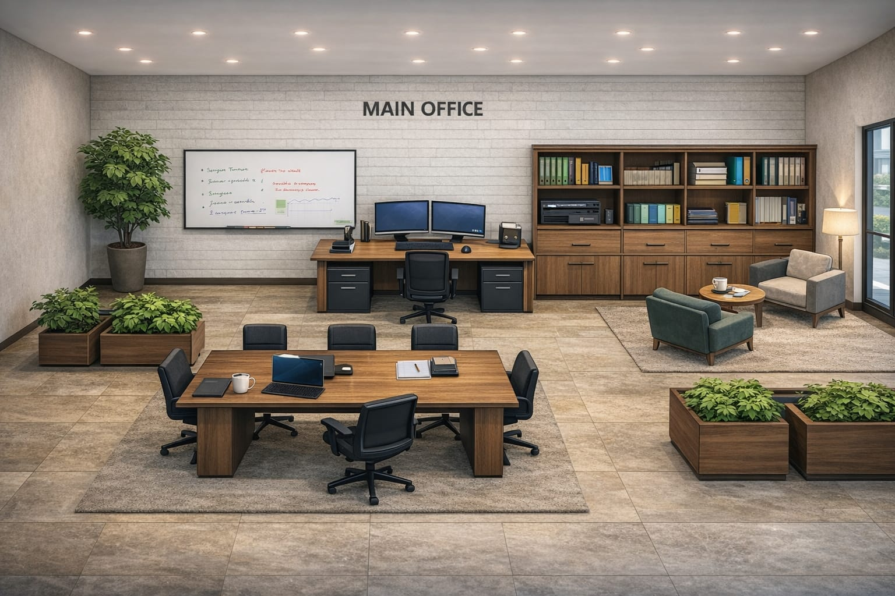
Main office
Main desk
Meeting table
Round side table
Swivel office chairs
Armchairs
Wooden shelving unit
Drawer cabinets
Computers
Monitors
Laptop
Keyboard and mouse
Whiteboard
Glass windows
Carpets
Floor lamp
Recessed ceiling lights
Potted plants
Planters
Mugs
Notebooks

